Slide 1
Navgujarat Bca collage:
Sem:-5
Navgujarat Bca Collage
Software Development
Project-1
1
Group No:-10
Year:-2023-24

Slide 2
Navgujarat Bca collage:
Sem:-5
Definition
2
Only
Pets..
SDP
Year:-2023-24

Slide 3
Navgujarat Bca collage:
Sem:-5
Only Pets:-
3
Only pets is the platform where all fashion related gaps between pets is identified and gets proper fashion tips to pets.
Only pets mainly solves the problems Of pets regarding to there clothes, accessories, grooming etc
Only pets is a platform where the owners of the pets can find best fashion options for there loving pets
Only pets finds the best quality wearables for you're loving kids through online in a easy way
SDP
Year:-2023-24

Slide 4
Navgujarat Bca collage:
Sem:-5
Group Member
4
Name:-
Vaghela Meet Jayeshbhai
Vangpapandu Chintansaicharan Pandurangarao
Zanzrukiya Mayur Hasmukbhai
Internal Guide: - Pro Jaimin Rohit
Sdp Incharge: - Pro Devraj Jadav
SDP
Year:-2023-24

Slide 5
Navgujarat Bca collage:
Technology
Sem:-5
5
Frontend:- Flutter,Dart Language
Backend:- Node(Api)
Database:- My Sql
SDP
Year:-2023-24

Slide 6
Navgujarat Bca collage:
Sem:-5
Company Details
6
Name:-
Query Finders Solutions
Website:-
http://www.queryfinders.com/
510,Satva icon, Vastral Metro station
Ahmedabad, GUJRAT 382418
Address:-
Phone No:- + 91 8000-841-620
SDP
Year:-2023-24

Slide 7
Navgujarat Bca collage:
Sem:-5
Point to be Discussed
7
Category.
Pets Category
Dog
Cat
Rabbit
SDP
Year:-2023-24

Slide 8
Navgujarat Bca collage:
Dog
Sem:-5
8
In dogs Category
Gender
Month
Male
Female
5 month
to
15 Year
SDP
Year:-2023-24

Slide 9
Modules
Navgujarat Bca collage:
Sem:-5
9
Customer:-
Register
Login
View Product
Cart Add
Make Payment
Give Feedback
Give Rating
Edit Profile
Logout
Admin:-
Login
Manage Customer
Manage Product
Manage Payment
Manage Feedback
Mange Order
Edit Profile
Manage Welfare Amount
Logout
SDP
Year:-2023-24

Slide 10
Navgujarat Bca collage
Sem:-5
10
It’s All About Exploring & Learning
9
Thank you..
SDP
Year:-2023-24

Slide 11
System Flow Diagram
Navgujarat Bca collage
Sem:-5
11
Year:-2023-24
SDP

Slide 12
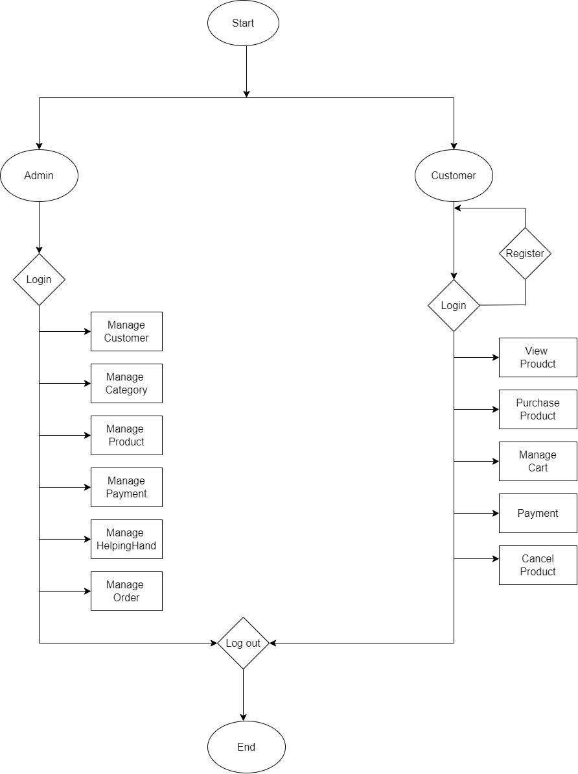
Navgujarat Bca collage:
Sem:-5
12
Year:-2023-24
SDP

Slide 13
Enity Relatioship Digram
Navgujarat Bca collage
Sem:-5
13
Year:-2023-24
SDP

Slide 14
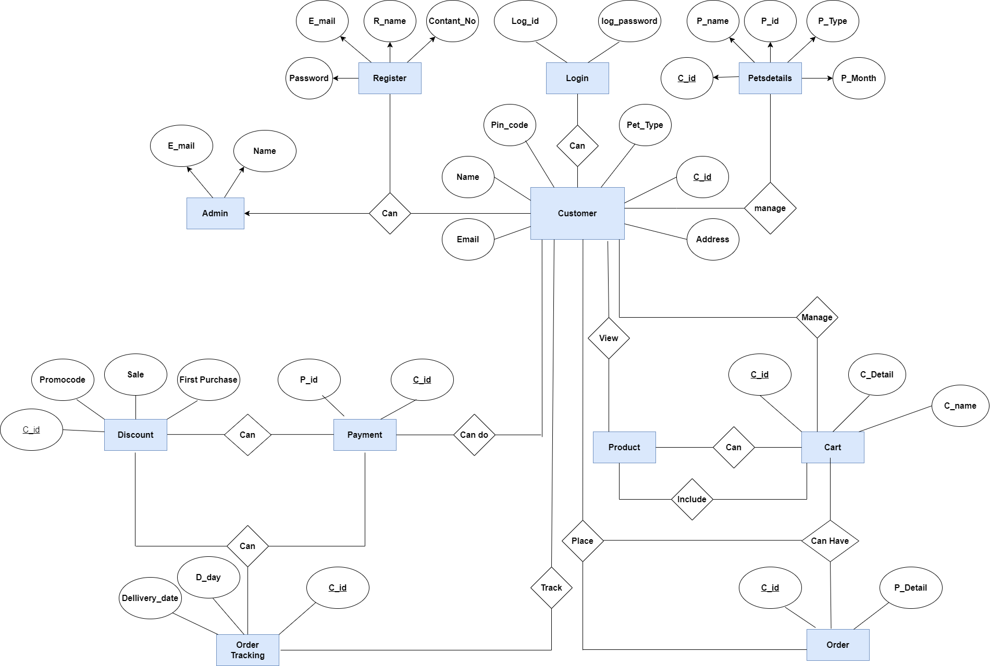
Navgujarat Bca collage:
Sem:-5
14
Year:-2023-24
SDP

Slide 15
Usecase Diagram
Navgujarat Bca collage
Sem:-5
15
Year:-2023-24
SDP

Slide 16
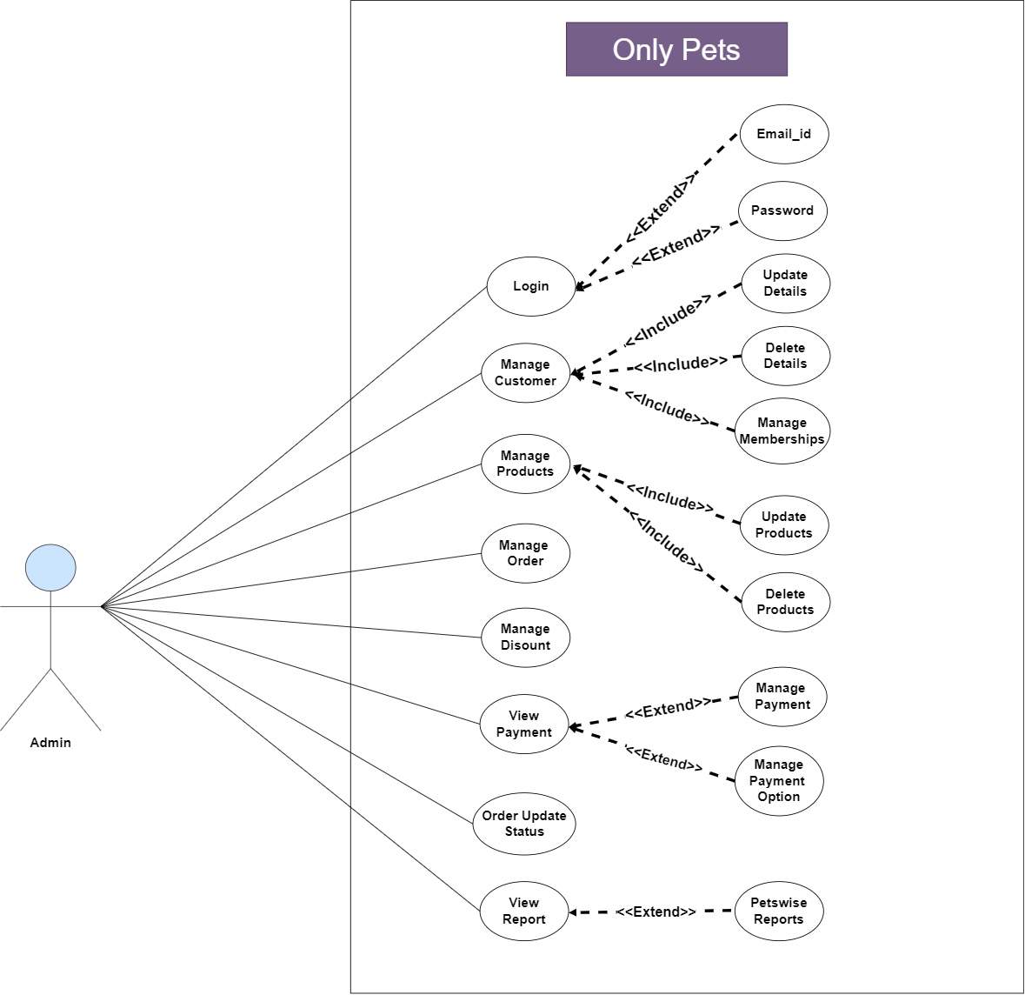
Navgujarat Bca collage:
Sem:-5
16
Year:-2023-24
SDP

Slide 17
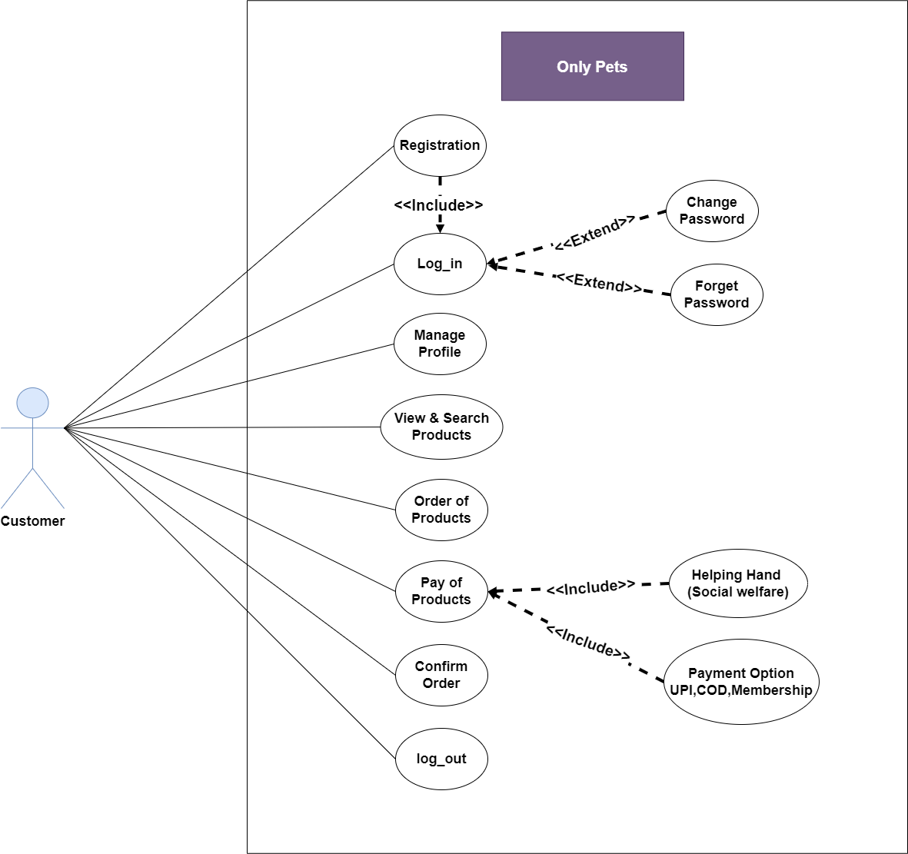
Navgujarat Bca collage:
Sem:-5
17
Year:-2023-24
SDP

Slide 18
Activity Digram
Navgujarat Bca collage
Sem:-5
18
Year:-2023-24
SDP

Slide 19
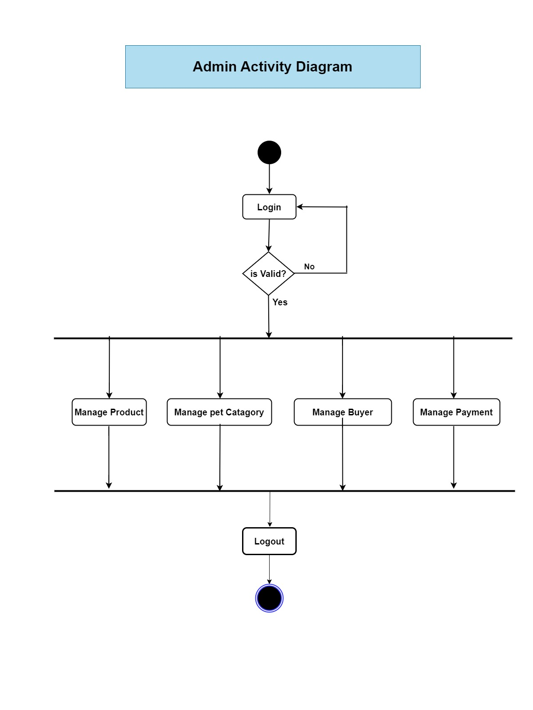
Navgujarat Bca collage:
Sem:-5
19
Year:-2023-24
SDP

Slide 20
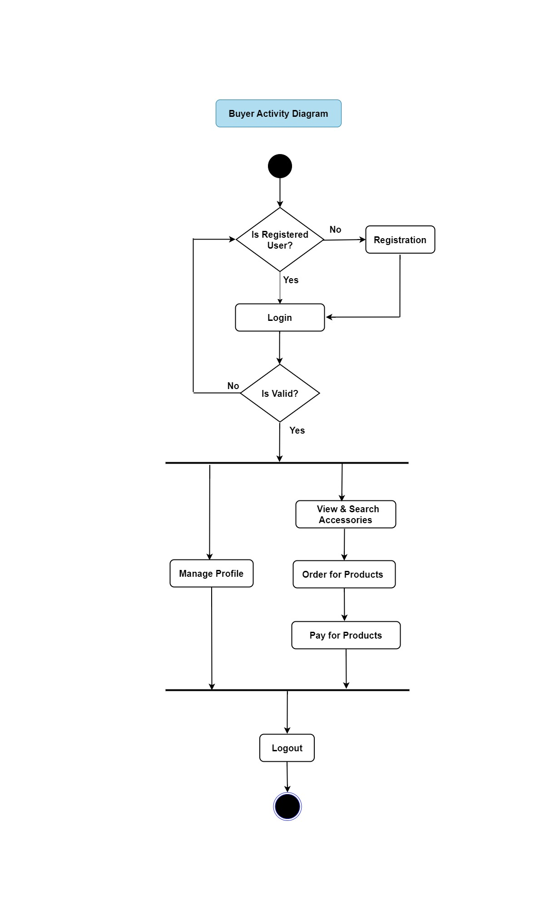
Navgujarat Bca collage:
Sem:-5
20
Year:-2023-24
SDP

Slide 21
Class Diagram
Navgujarat Bca collage
Sem:-5
21
Year:-2023-24
SDP

Slide 22
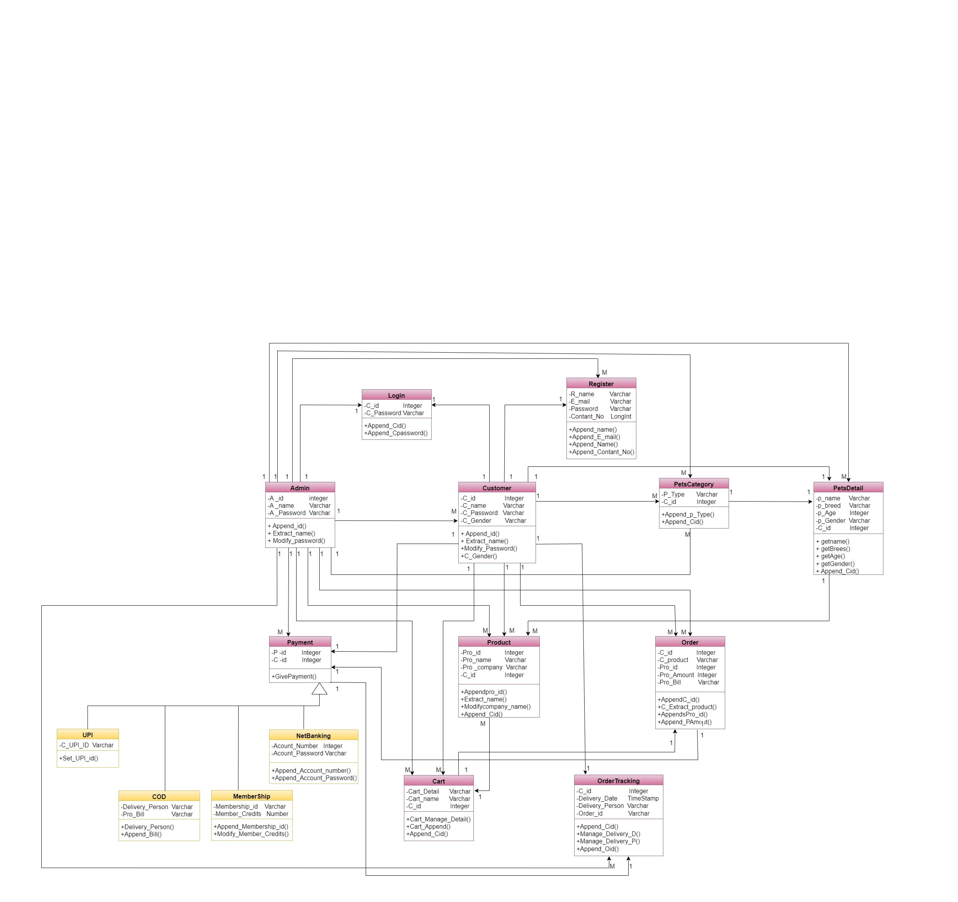
Navgujarat Bca collage:
Sem:-5
22
Year:-2023-24
SDP

Slide 23
Sequence Digram
Navgujarat Bca collage
Sem:-5
23
Year:-2023-24
SDP

Slide 24
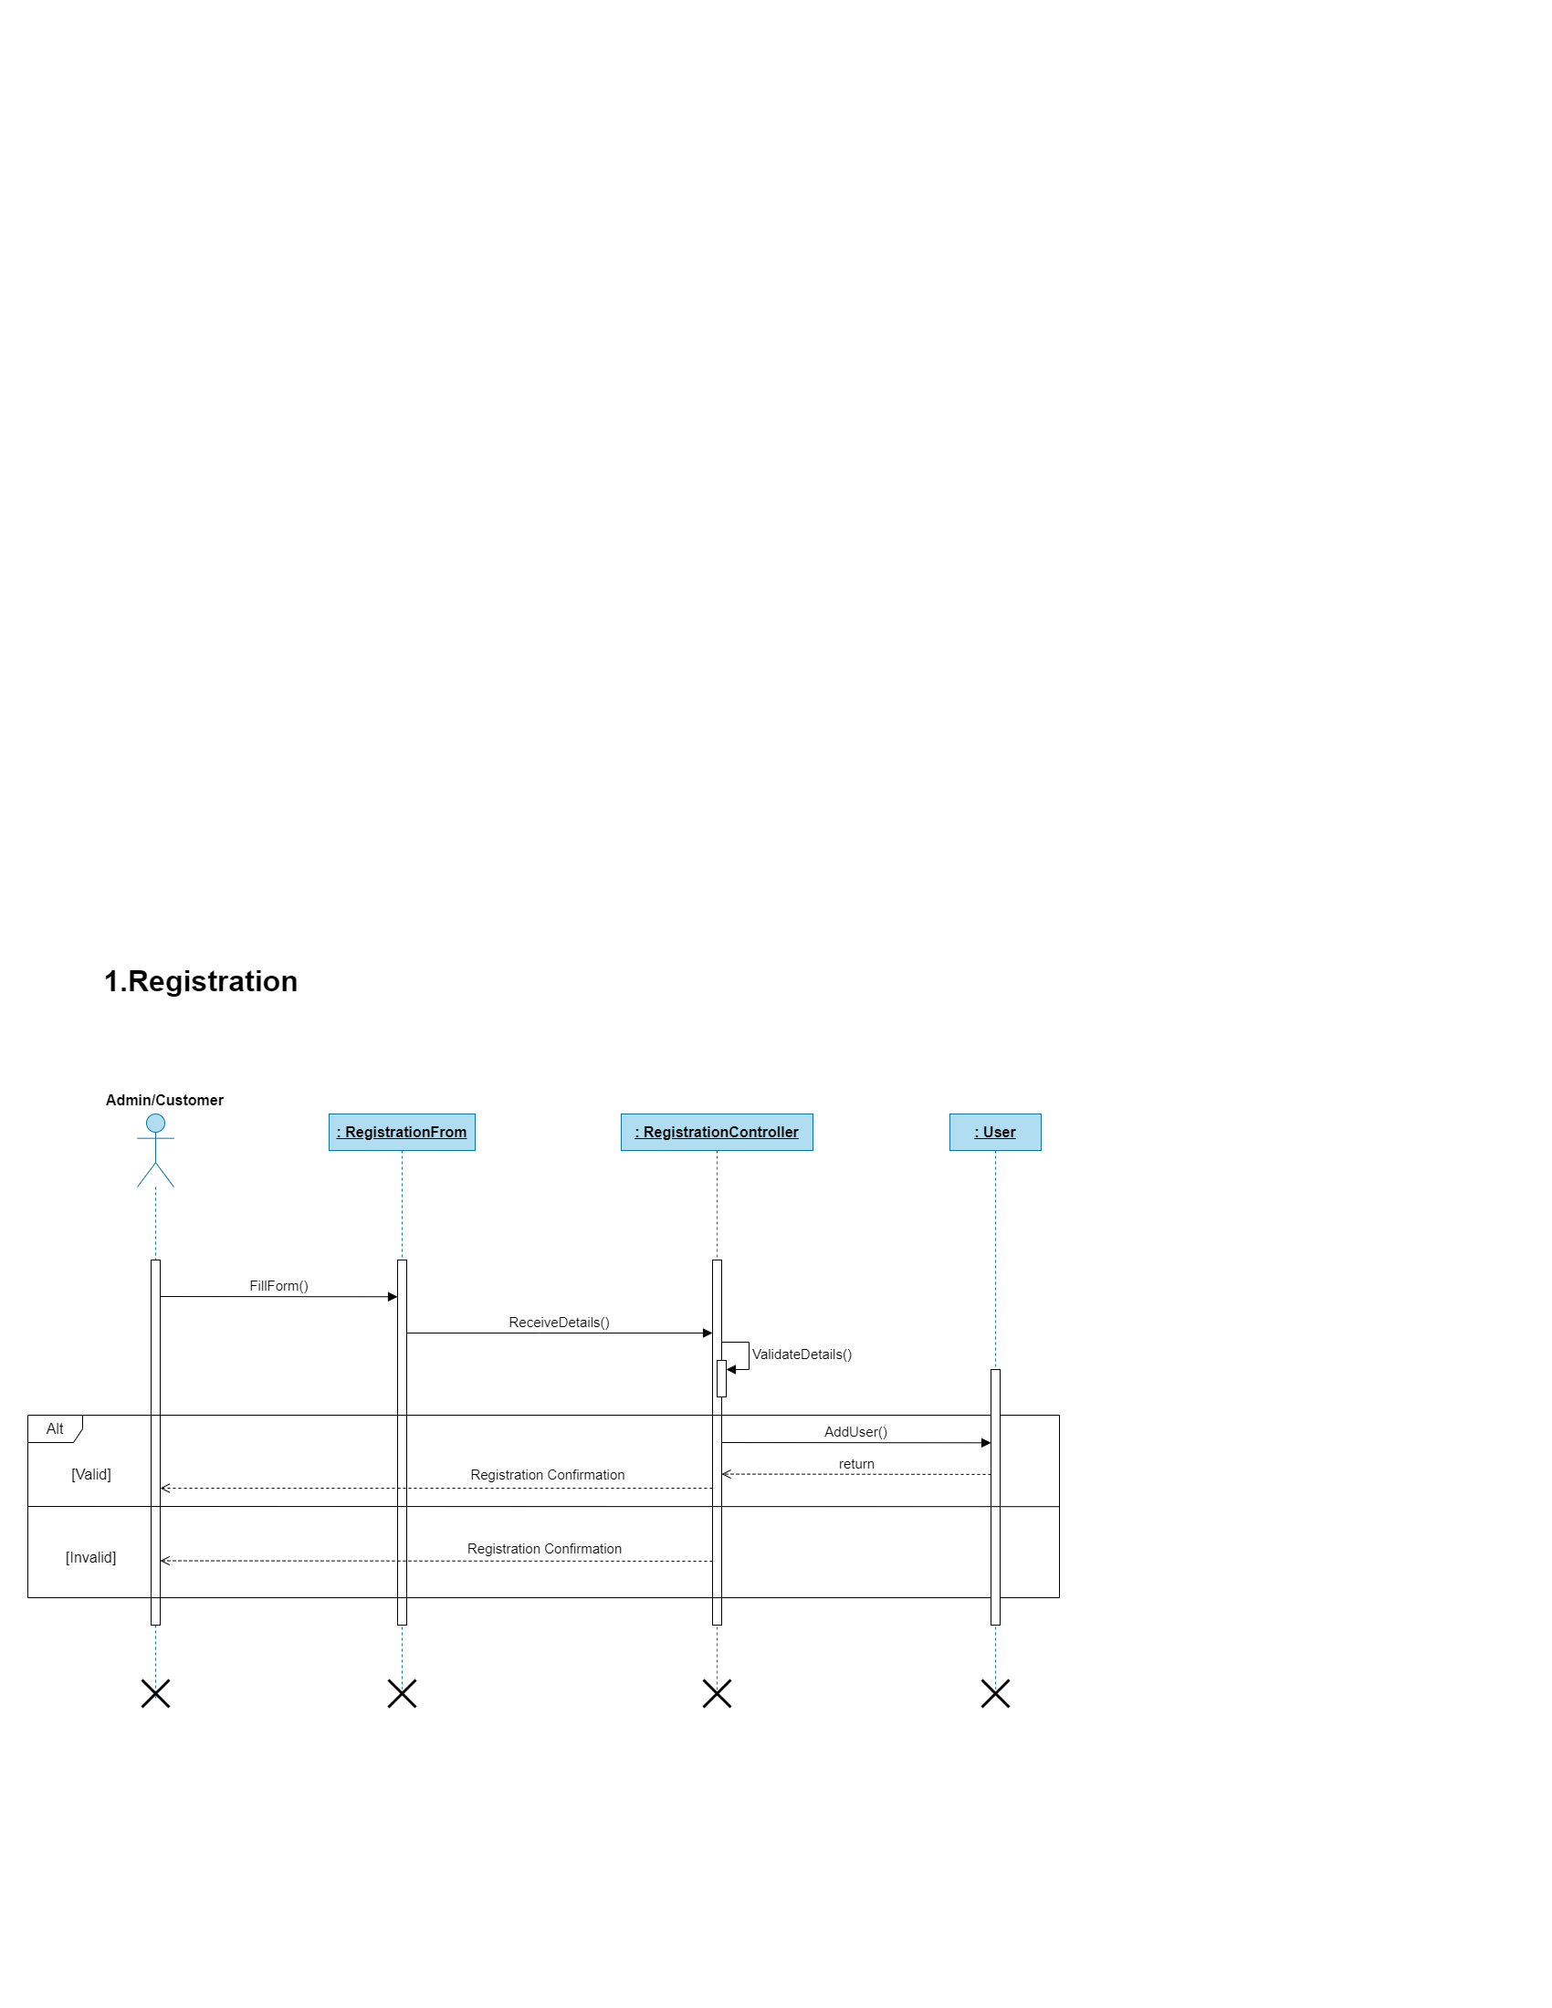
Navgujarat Bca collage:
Sem:-5
24
Year:-2023-24
SDP

Slide 25
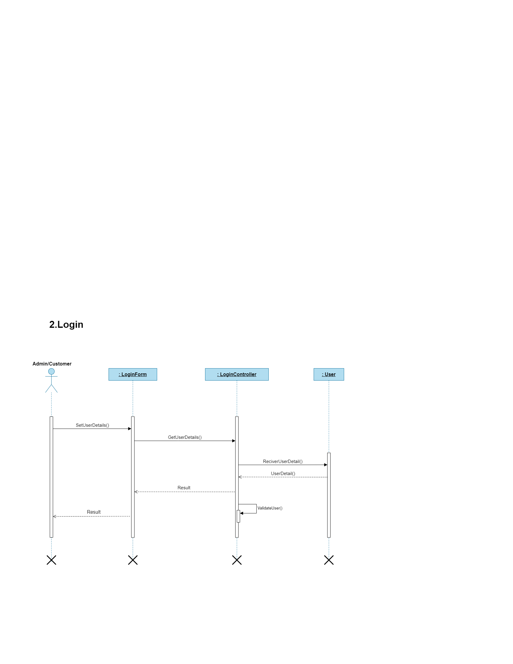
Navgujarat Bca collage:
Sem:-5
25
Year:-2023-24
SDP

Slide 26
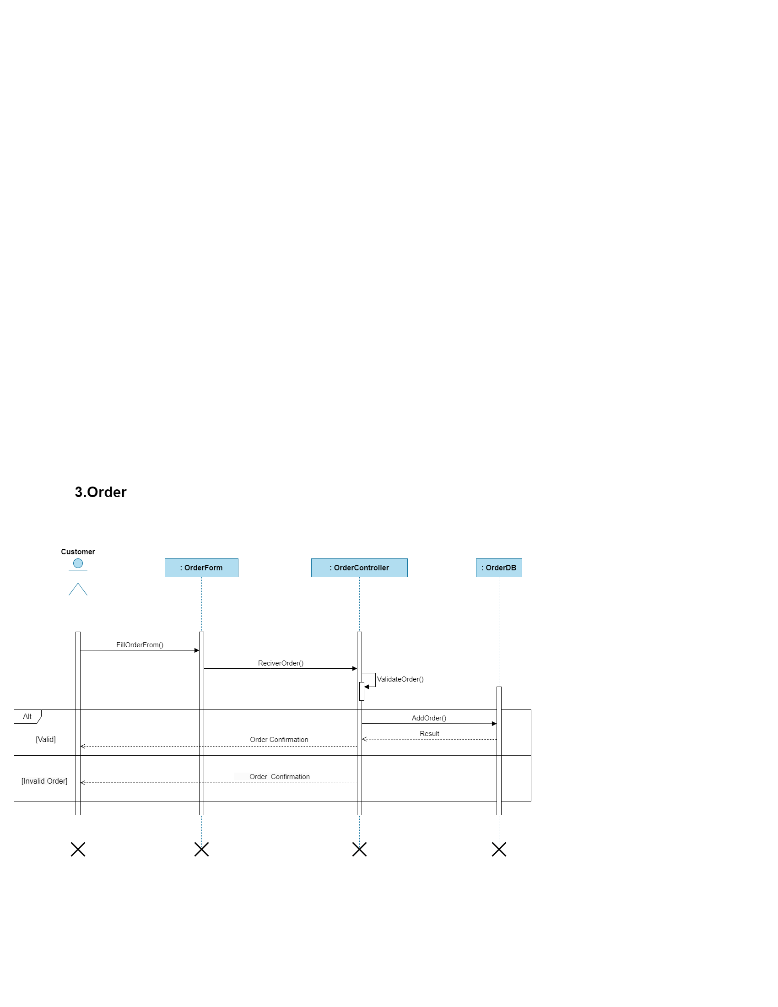
Navgujarat Bca collage:
Sem:-5
26
Year:-2023-24
SDP

Slide 27
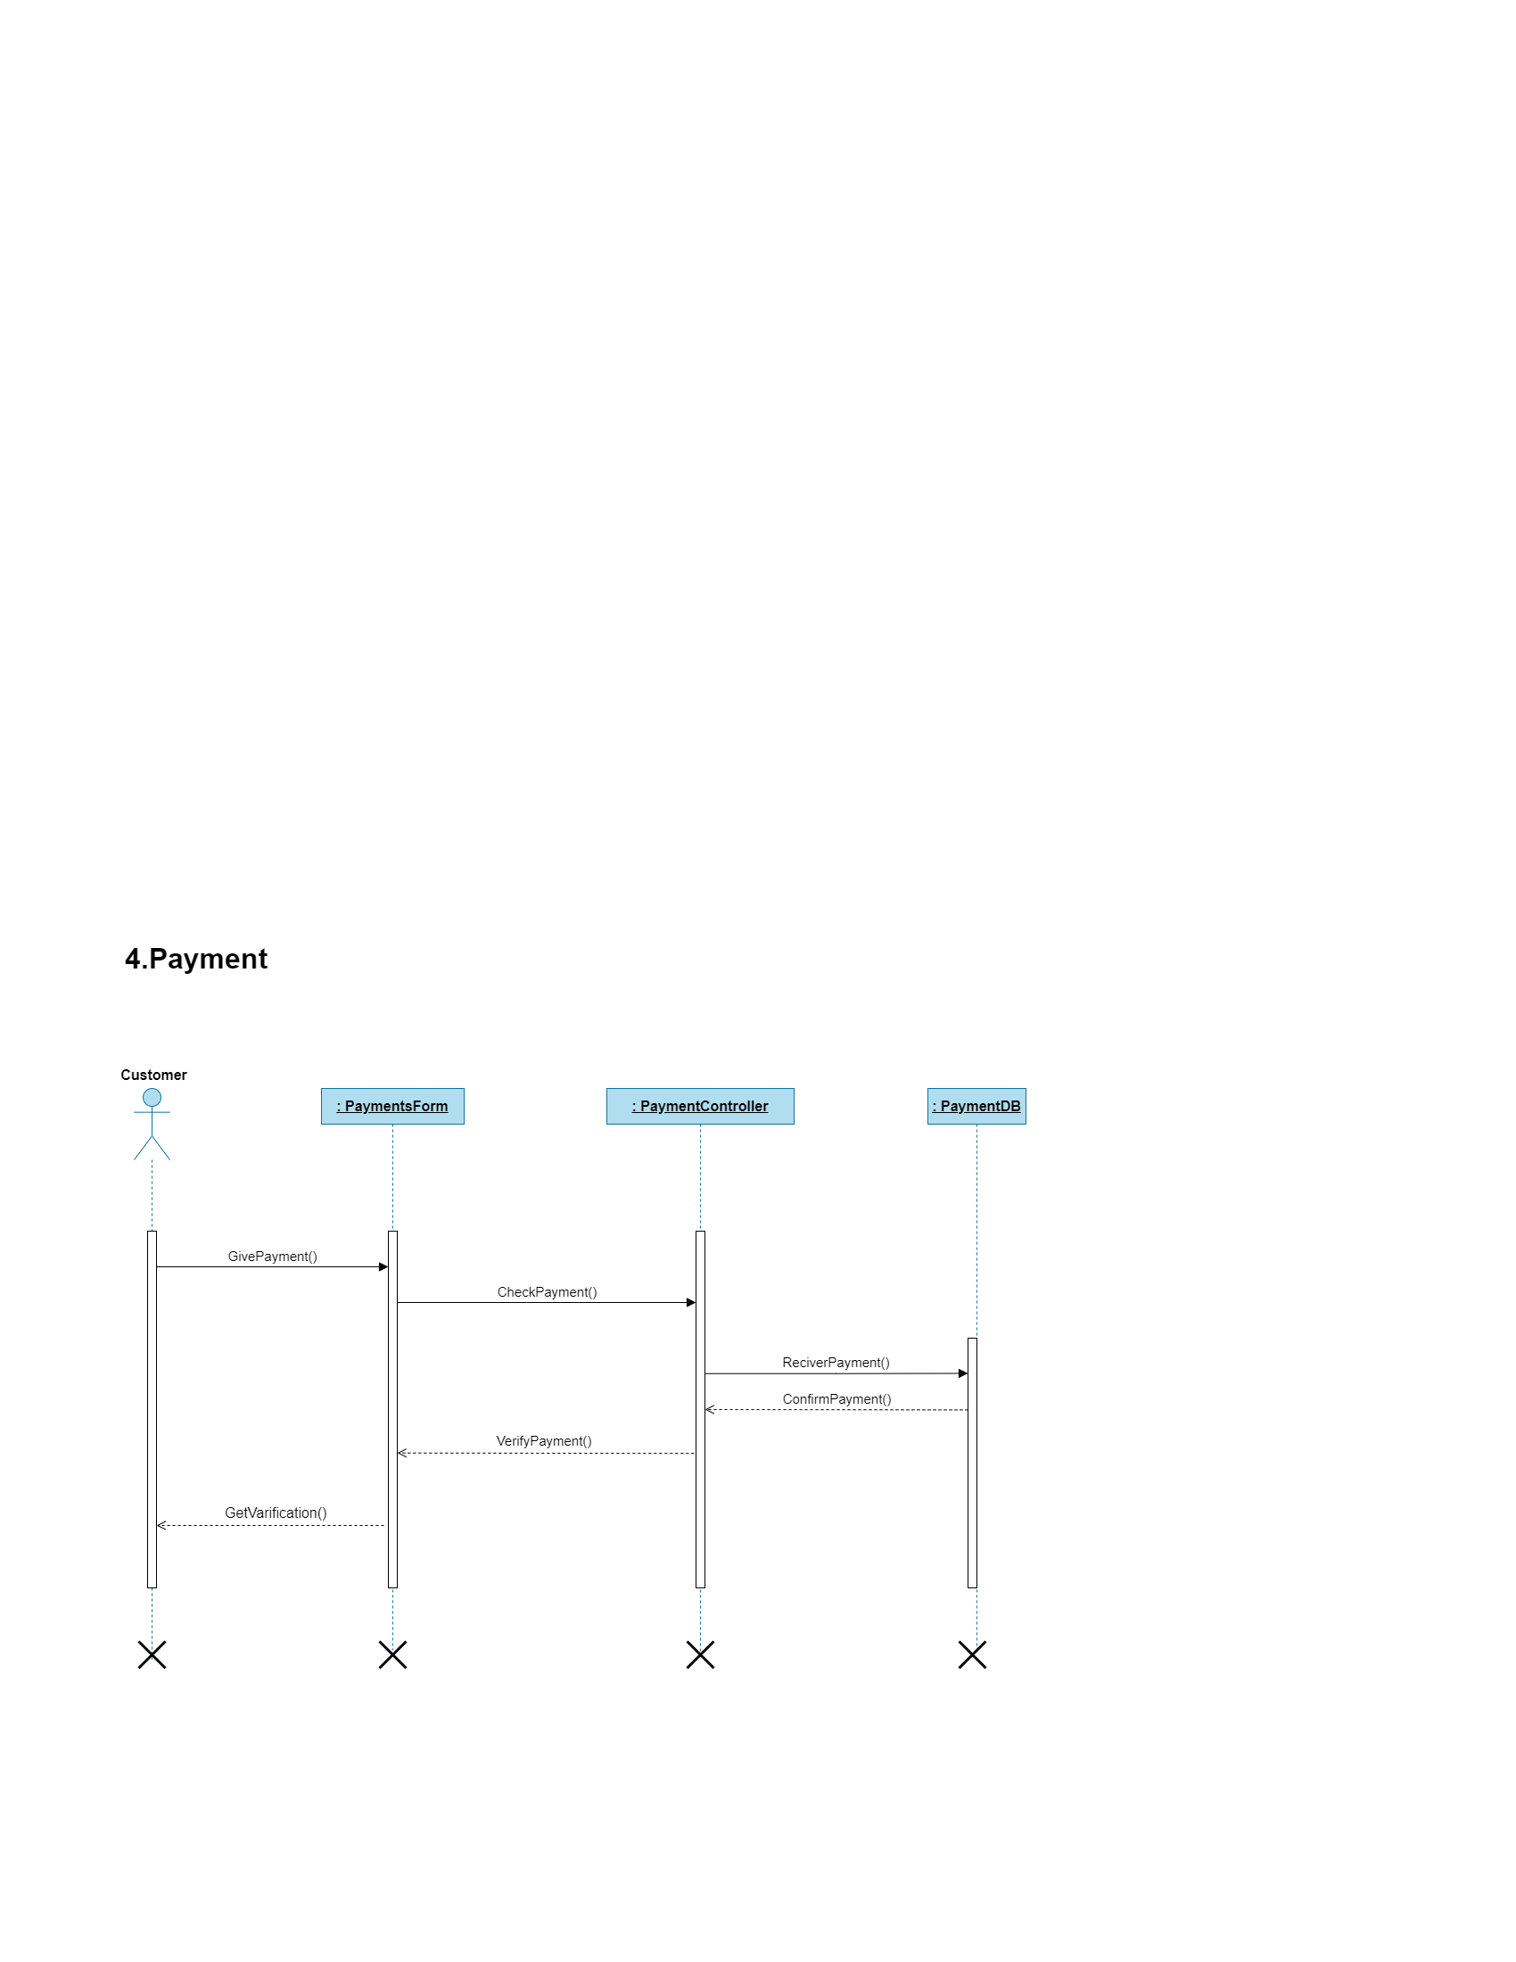
Navgujarat Bca collage:
Sem:-5
27
Year:-2023-24
SDP

Slide 28
Data Dictionary
Navgujarat Bca collage
Sem:-5
28
Year:-2023-24
SDP

Slide 29
Navgujarat Bca collage:
Sem:-5
29
Data Dictionary
Tables
User Types
Login
Customer
City
Pet_Categories
Pet Details
Products
Product_Categories
9)Product_Brands
10) Order
11) Order_Details
12) Order_Cancle
13) Promo_code
14) Addresses
15) Payments
16) Order_Status
17) Order_Status_Details
18) WellFare_Amount
19) FeedBack
Year:-2023-24
SDP

Slide 30
Navgujarat Bca collage:
User Types
Sem:-5
30
1).Table Name:- User_Types
Table Description:- This Table Includes Customer_id &
Name User type like Admin & Customer.
Primary Key:- Id
Attributes | Datatype | Constrain | Description
Id | Int | Primary Key A_I | This Row Include The unique id of each user type
Name | Text | Not Null | The Unique id of each user type.
Year:-2023-24
SDP

Slide 31
Navgujarat Bca collage:
Login
Sem:-5
2).Table Name:- Login
Table Description:- This Table Include id, User_id, Password, Customer_Type_id.
Primary Key:- Id
Foregin Key:- Customer_Type_id.
31
Column Name | Datatype | Constrain | Description
Id | Int | Primary Key A_I | Stores unique for every row
User_id | Int | Not null | Store user name
Password | text | Not null | Store user password
Customer_type_id | text | Foreign Key | Store User_type_id
Year:-2023-24
SDP

Slide 32
Navgujarat Bca collage:
Customer
Sem:-5
3).Table Name:- Customer
Table Description:- This Table Include id, Name, Login_id, Contact_Num, Address,Gender, City_id, Pet_Category_id.
Primary Key:- Id
Foregin Key:- Login_id,City_id,Pet_Category
32
Column Name | Datatype | Constrain | Description
Id | Int | Primary Key A_I | Stores unique for every row
Name | Text | Not null | Store user name
Contact_Num | Decimal | Not null | Store user contact_num
Login_id | Text | Foregin Key | Store user login_id
Address | Text | Not null | Store user Address
Gender | Text | Not null | Store user gender
City_id | Int | Foregin Key | Store user city
Pet_Category_id | Int | Foregin Key | Store user Pet_category_id
Year:-2023-24
SDP

Slide 33
Navgujarat Bca collage:
Sem:-5
City
4).Table Name:- City
Table Description:- Store User id,City_Name.
Primary Key:- Id
33
Column Name | Datatype | Constrain | Description
Id | Int | Primary Key A_I | Stores unique for every row
City_Name | Text | Not null | Store city_name
Year:-2023-24
SDP

Slide 34
Navgujarat Bca collage:
Sem:-5
Pet_Categories
34
5).Table Name:- Pet_Categories
Table Description:- This Table Include id, Name,Thumbnail_url,
Primary Key:- Id
Column Name | Datatype | Constrain | Description
Id | Int | Primary Key A_I | Stores unique for every row
Name | Text | Not null | Store user name
Thumbnail_url | Text | Not null | Store user Thumbnail_url
Year:-2023-24
SDP

Slide 35
Navgujarat Bca collage:
Pet_Details
Sem:-5
6).Table Name:- Pet_Details
Table Description:- This Table Include id,Name, Pet_Category_id, Nik_Name.Dob, Cuatomer_id, Photo_url, Description_
Primary Key:- Id
Foregin Key:- Pet_Category_id.
35
Column Name | Datatype | Constrain | Description
Id | Int | Primary Key A_I | Store user id & pet_details
Name | Text | Not null | Store user name
Pet_Category_id | Int | Foregin Key | Store user Pet_Category_id
Nike_Name | Text | Not null | Store user nike_name
Dob | Date | Not null | Store user dob
Customer_id | Int | Not null | Store user customer_id
Photo_url | Text | Not null | Store user photo_url
Description | Text | Not null | Store user description
Year:-2023-24
SDP

Slide 36
Navgujarat Bca collage:
Product
Sem:-5
7).Table Name:- Product
Table Description:- This Table Include id, Name, Product_Category_id, Brand_id, Photo_url_1, Photo_url_2, Thumbnail_url, Description, Price, Discount_Price.
Primary Key:- Id
Foregin Key:- Product_Category_id, Brand_id.
36
Column Name | Datatype | Constrain | Description
Id | Int | Primary Key A_I | Stores unique for every row
Name | Text | Not null | Store user name
Product_Category_id | Int | Foregin Key | Store user Product_Category_id
Brand_id | Int | Foregin Key | Store brand_id
Photo_url_1 | int | Not null | Store user thumbnail_url
Photo_url_2 | Int | Not null | Store pet thumbnail_url
Thumbnail_url | Text | Not null | Store user thumbnail_url
Description | Text | Not null | Store product Description
Price | Int | Not null | Store product Price
Discount_Price | Decimal | Not null | Store discount_Price
Batch No:
Year:-2023-24
SDP

Slide 37
Navgujarat Bca collage:
Product_Categories
Sem:-5
37
8).Table Name:- Product_Categories
Table Description:- This Table Include id, Name, Photo_url
Primary Key:- Id
Column Name | Datatype | Constrain | Description
Id | Int | Primary Key A_I | Stores unique for every row
Name | Text | Not null | Store user name
Photo_url | Int | Not null | Store user photo_url
Year:-2023-24
SDP

Slide 38
Navgujarat Bca collage:
Product_Brands
Sem:-5
38
9).Table Name:- Pet_Categories
Table Description:- This Table Include id, Name, Photo_url,
Primary Key:- Id
Column Name | Datatype | Constrain | Description
Id | Int | Primary Key A_I | Stores unique for every row
Name | Text | Not null | Store user name
Photo_url | Int | Not null | Store user photo_url
Year:-2023-24
SDP

Slide 39
Navgujarat Bca collage:
Order
Sem:-5
10).Table Name:- Order
Table Description:- This Table Include id, Customer_id, Date_of_Order, Amount, Discount, Promocode_id, Delivery_address_id
Primary Key:- Id
Foregin Key:-Customer_id,Promocode_id,Delivery_address_id
39
Column Name | Datatype | Constrain | Description
Id | Int | Primary Key A_I | Stores unique for every row
Customer_id | Int | Foregin Key | Store customer_id
Date_of_order | Date | Not null | Store date_of_order
Amount | Decimal | Not null | Store the amount
Discount | Decimal | null | Store the discount
Promocode_id | Int | Foregin Key | Store the promocode_id
Delivery_address_id | Int | Foregin Key | Store Delivery_address_id
Batch No:
Year:-2023-24
SDP

Slide 40
Navgujarat Bca collage:
Order_Detail
Sem:-5
40
11).Table Name:- Order_Detail
Table Description:- This Table Include id, Order_id, Product_id, Quantity
Primary Key:- Id
Foregin Key:-Quantity
Column Name | Datatype | Constrain | Description
Id | Int | Primary Key A_I | Stores unique for every row
Order_id | Text | Not null | Store user Order_id
Product_id | Text | Not null | Store Product_id
Quantity | Int | Not null | Store user Quantity
Year:-2023-24
SDP

Slide 41
Navgujarat Bca collage:
Promo_code
Sem:-5
13).Table Name:- Promo_code
Table Description:- This Table Include id, Promo_code_title, Discount_per, Start_date, End_date, Limits, Min_amount
Primary Key:- Id
41
Column Name | Datatype | Constrain | Description
Id | Int | Primary Key A_I | Stores unique for every row
Promo_code_title | Text | Not null | Store the promo_code_title
Discount_per | Decimal | Not null | Store discount_per
Start_date | Date | Not null | Store the validity of Start_date
End_date | Date | Not null | Store the validity of End_date
Limits | Int | Not null | Store the limitations of Limits
Min_amount | Int | Not null | Store the validation of Min_amount
Year:-2023-24
SDP

Slide 42
Navgujarat Bca collage:
Address
Sem:-5
14).Table Name:- Address
Table Description:- This Table Include id, Customer_id, Street_name, Street_no, Contact_no, Contact_person_name, pincode, City_id
Primary Key:- Id
Foregin Key:- Customer_id,City_id
42
Column Name | Datatype | Constrain | Description
Id | Int | Primary Key A_I | Stores unique for every row
Customer_id | Int | Foregin Key | Store customer_id
Street_name | Text | Not null | Store the locality
Street_no | Int | Not null | Store the locality no
Contact_no | Decimal | Not null | Store the user contact_no
Contact_person_name | Text | Not null | Store the user Contact_person_name
Pincode | Int | Not null | Store the locality pincode
City_id | Int | Foregin Key | Store the city_id
Batch No:
Year:-2023-24
SDP

Slide 43
Navgujarat Bca collage:
Payment
Sem:-5
15).Table Name:-Payment
Table Description:- This Table Include id, Order_id, Amount, Transaction_id, Status, Walefare_amount
Primary Key:- Id
Foregin Key:-Order_id
43
Column Name | Datatype | Constrain | Description
Id | Int | Primary Key A_I | Stores unique for every row
Order_id | Int | Foregin Key | Store the order_id
Amount | Int | Not null | Store the amount of product
Transaction_id | Text | Not null | Store the transaction_id of user
Status | Int | Not null | Store the payment status
Walefare_amount | Int | Not null | Store the charity amount from user
Batch No:
Batch No:
Year:-2023-24
SDP

Slide 44
Navgujarat Bca collage:
Sem:-5
Order_Status
44
16).Table Name:-Order_status
Table Description:- This Table include Id, Status_name
Primary Key:- Id
Column Name | Datatype | Constrain | Description
Id | Int | Primary Key A_I | Stores unique for every row
Status_name | Text | Not null | Store the stutus_name
Year:-2023-24
SDP

Slide 45
Navgujarat Bca collage:
Order_Status_Detail
Sem:-5
17).Table Name:-Order_status_detail
Table Description:- This Table include Id, Order_id, Status_id, Data_of_Status,Time_of_Status, Description
Primary Key:- Id
Foregin Key:- Order_id,Status_id
45
Column Name | Datatype | Constrain | Description
Id | Int | Primary Key A_I | Stores unique for every row
Order_id | Int | Foregin Key | Store the order_id
Status_id | Int | Foregin Key | Store the status_id
Date_of_Status | Date | Not null | Store the Date_of_Status
Time_of_Status | Date&Time | Not null | Store the Time_of_Status
Description | Int | null | Store the user Description
Year:-2023-24
SDP

Slide 46
Navgujarat Bca collage:
Welfare_Amount
Sem:-5
18).Table Name:- Welfare_Amount
Table Description:- This Table include Id, Order_id, Customer_id, Amount, Date_of_Transaction, Time_of_Transaction
Primary Key:- Id
Foregin Key:- Customer_id, Order_id
46
Column Name | Datatype | Constrain | Description
Id | Int | Primary Key A_I | Stores unique for every row
Customer_id | Int | Foregin Key | Store the Customer_id
Order_id | Int | Foregin Key | Store the Order_id
Amount | Date | Not null | Store the Amount
Date_of_Transaction | Date&Time | Not null | Store the Date_of_Transaction
Time_of_Transaction | Int | Null | Store the Time_of_Transaction
Batch No:
Year:-2023-24
SDP

Slide 47
Navgujarat Bca collage:
Feedback
Sem:-5
19).Table Name:- Feedback
Table Description:- This Table include Id,Order_id, Product_id, Message, Rating_star, Date_of_Review, pics_url, Video_url
Primary Key:- Id
Foregin Key:-Product_id, Order_id
47
Column Name | Datatype | Constrain | Description
Id | Int | Primary Key A_I | Stores unique for every row
Product_id | Int | Foregin Key | Store the Product_id
Order_id | Int | Foregin Key | Store the Order_id
Message | Date | Not null | Store the Message
Rating_Star | Text | Null | Store the Rating_Star
Date_of_Review | Date&time | Null | Store the Date_of_Review
Pics_Url | Text | Null | Store the pics_url
Video_Url | Text | Null | Store the video_url
Batch No:
Batch No:
Year:-2023-24
SDP

Slide 48
Navgujarat Bca collage:
Sem:-5
Biblio Graphy
48
https://dart.dev/tutorials
-> It is used to learn core programming in data language
https://ui8.net/lehieuds/products/fancy-flower-gift-delivery
-> It is used to Design some attrative layout in this project
https://stackoverflow.com/
-> It is used to any error solve this website
https://www.tutorialspoint.com/dart_programming/index.htm
-> It is used to problem solve to Dart programming-language
Year:-2023-24
SDP

Slide 49
Navgujarat Bca collage:
Sem:-5
Conclusion
49
Only pets main intention is to provide best quality ecosystem to there owners because when it comes to human fashion there are multiple stores there multiple platforms for shopping but when it comes to pets there are very few options in market because of this our intention is to solve this issue ground rootedly
Only pets is not just only a app it will also work as social and society welfare while purchasing any product from us will contribute to a feature called 'HELPING HAND 'in this you can contribute directly through donations the main intention of "HELPING HAND" is to provide good life to stray animals even you will get every information about where the money is speeded for what reasons money is speeder there you can even meet them every Sunday also bring your own pets i will be playful for all
Year:-2023-24
SDP

Slide 50
Navgujarat Bca collage:
Sem:-5
50
Thank you….
Year:-2023-24
SDP

Slide 51
SDP-2

Slide 52


Slide 53
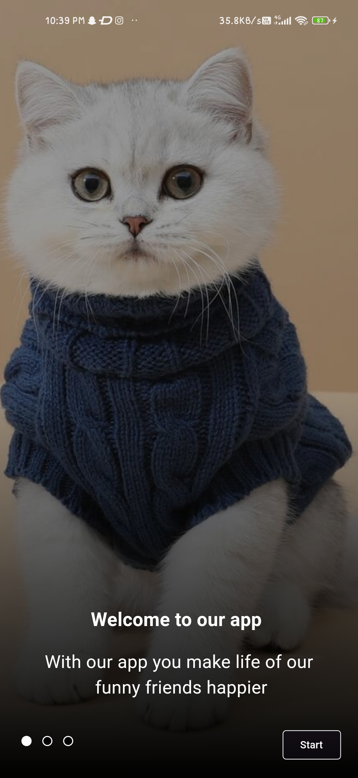
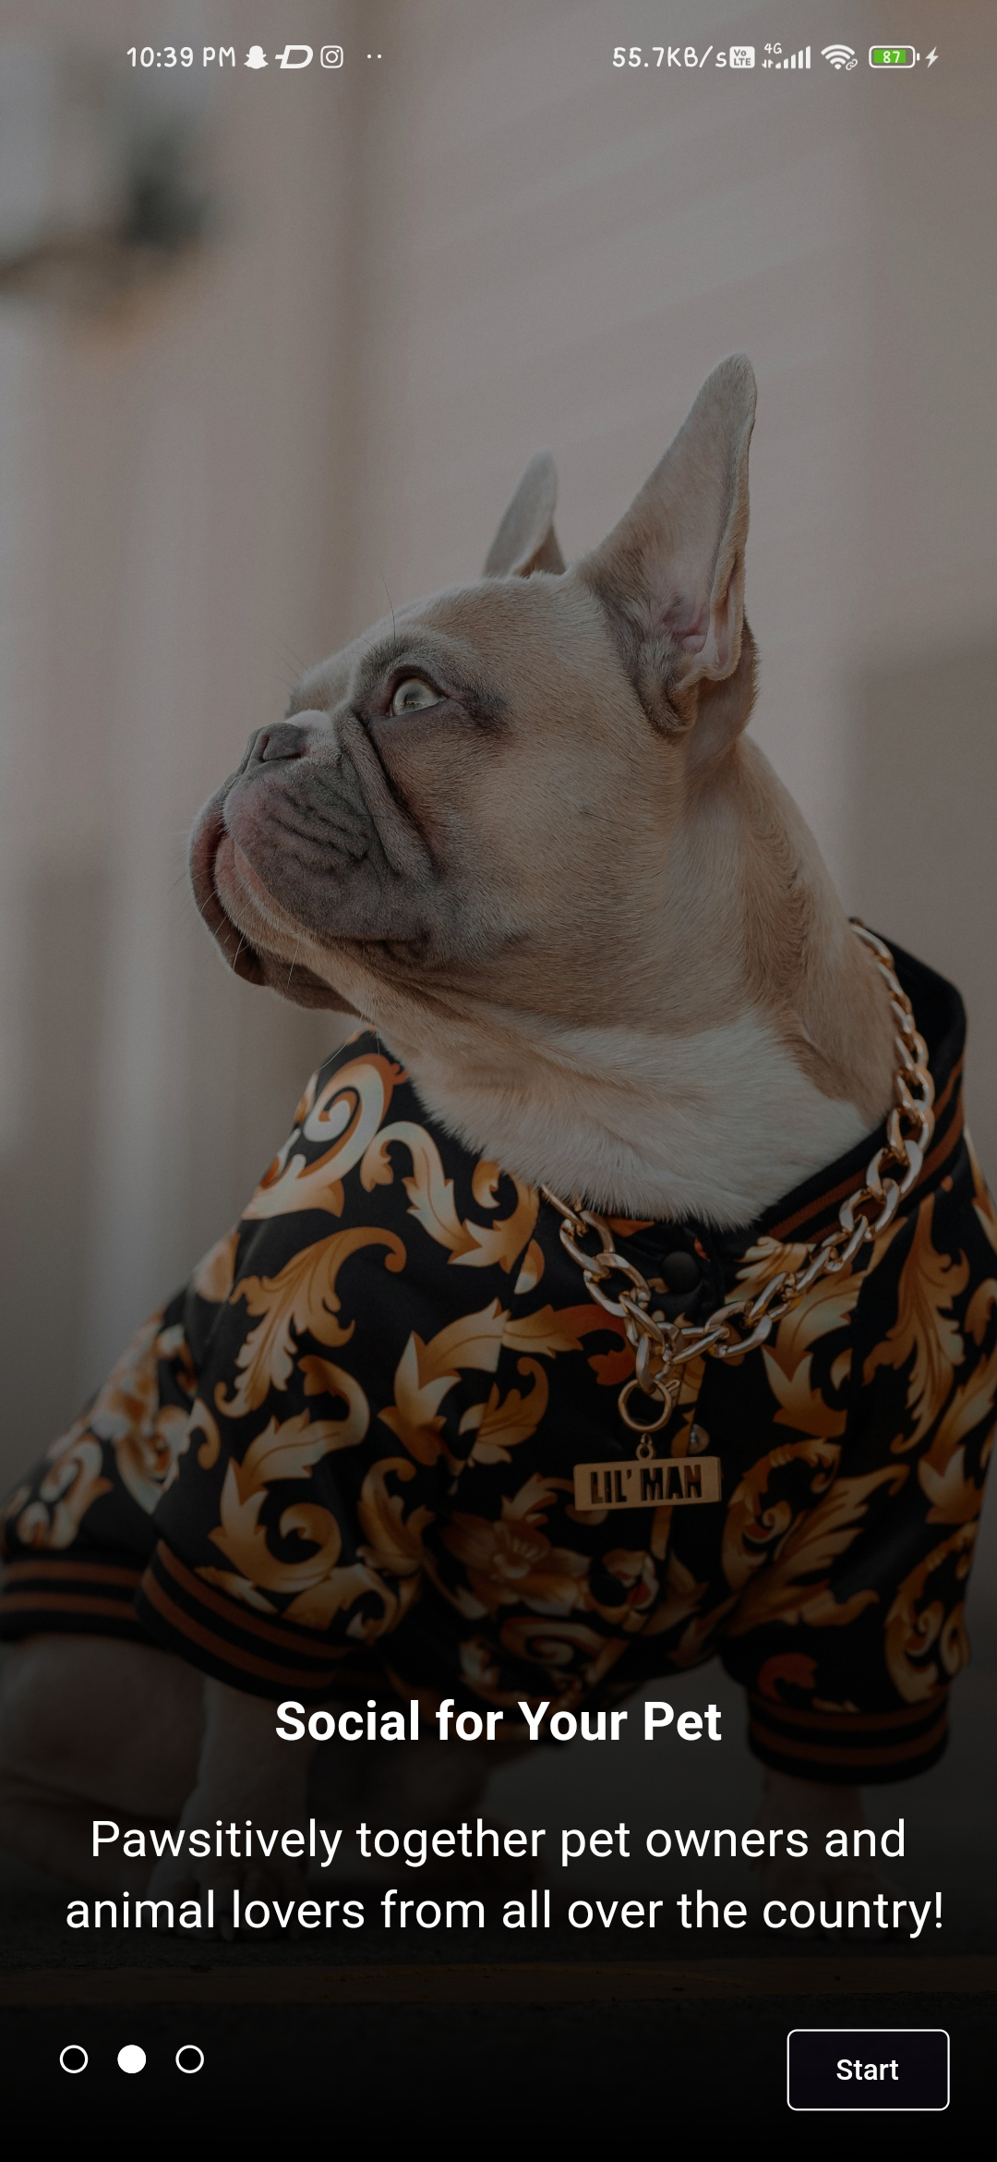
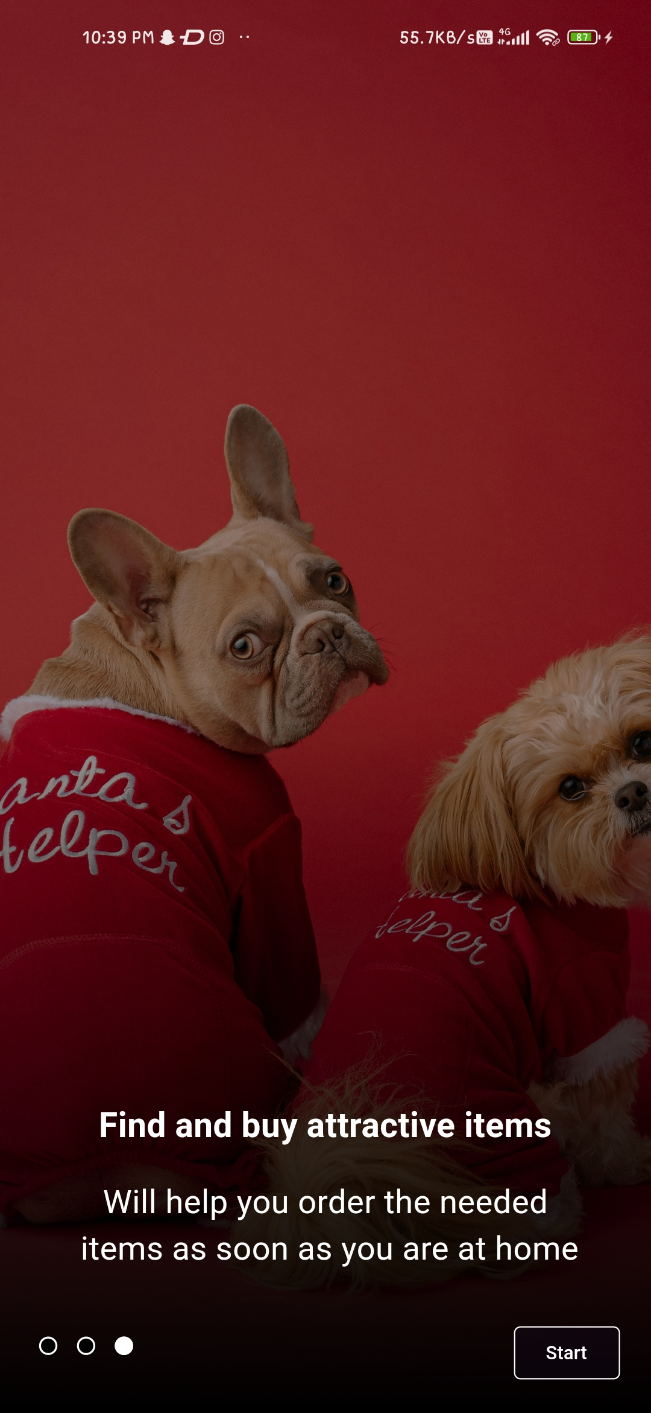

Slide 54
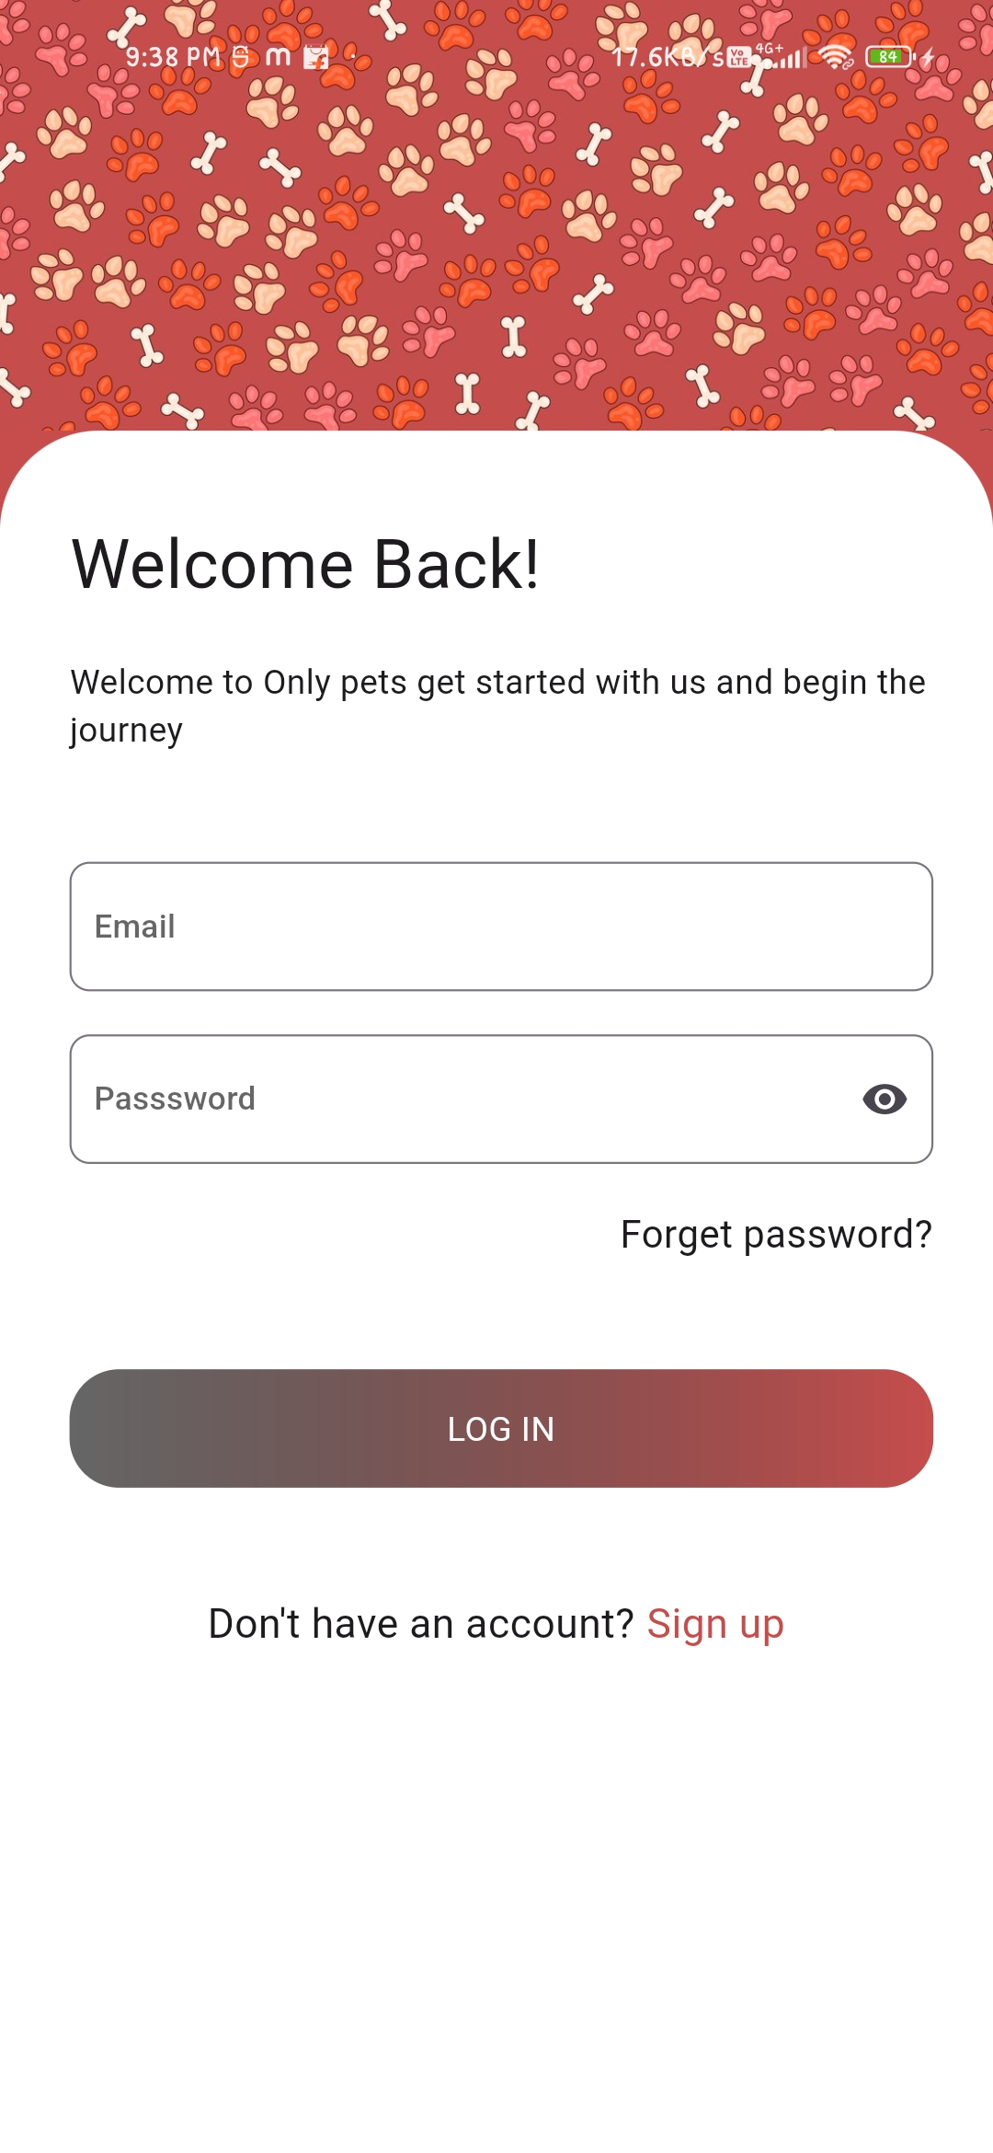
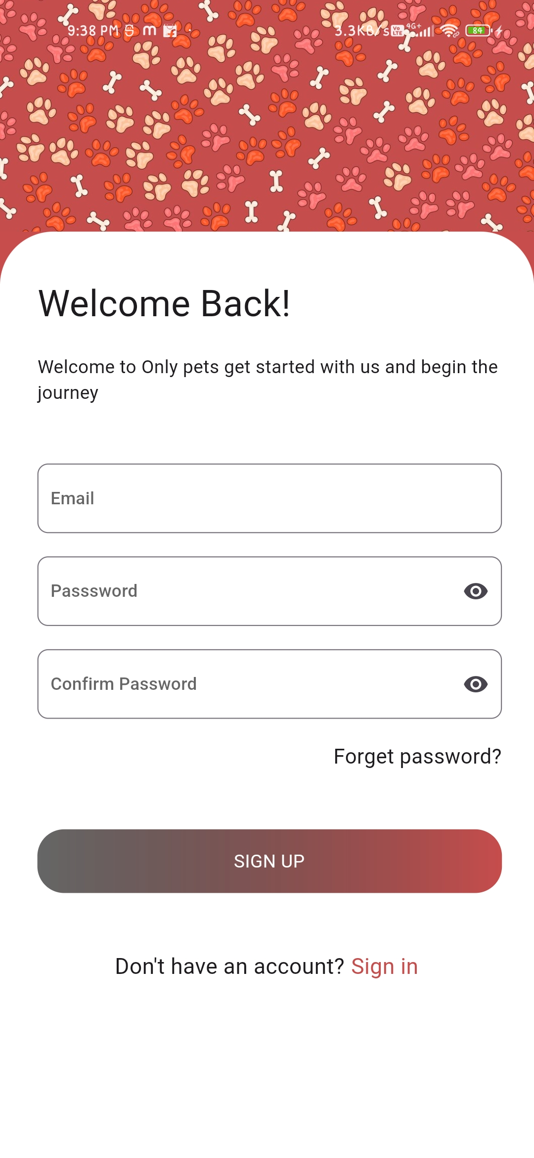

Slide 55
